Slide 1
Ubisecure APIs
Integration points with other systems

Slide 2
Agenda
This module introduces the main APIs of Ubisecure IAM products
UI and UX
Discovery, Template, Session Status, JavaScript
Application integration
Web SSO, Mobile Apps, API Protection
OAuth 2.0 and OpenID Connect 1.0
DevOps and Automation
SSO Management API
IAM Process
CustomerID API, OTP
Callback APIs
Directory Mapping, Backend Query, Authentication Methods

Slide 3
UI and UX
Discovery API
Application configuration information
What authentication methods and templates are enabled for application?
Localized text for certain UI elements, authentication method names, etc
Template API
Template configuration information
What languages are enabled? What login UI elements are enabled?
Access to resources such as CSS, logos, JavaScript etc

Slide 4
UI and UX – Examples
Discovery and Template
# Discovery API
Invoke-RestMethod "https://login.example.ubidemo.com/uas/discovery?entityID=sso-api-sample"
Invoke-RestMethod "https://login.example.ubidemo.com/uas/discovery?entityID=cn=Ubilogin,ou=System"
# Template API
Invoke-RestMethod "https://login.example.ubidemo.com/uas/template/default/json"
Invoke-RestMethod "https://login.example.ubidemo.com/uas/template/default/style.css"

Slide 5
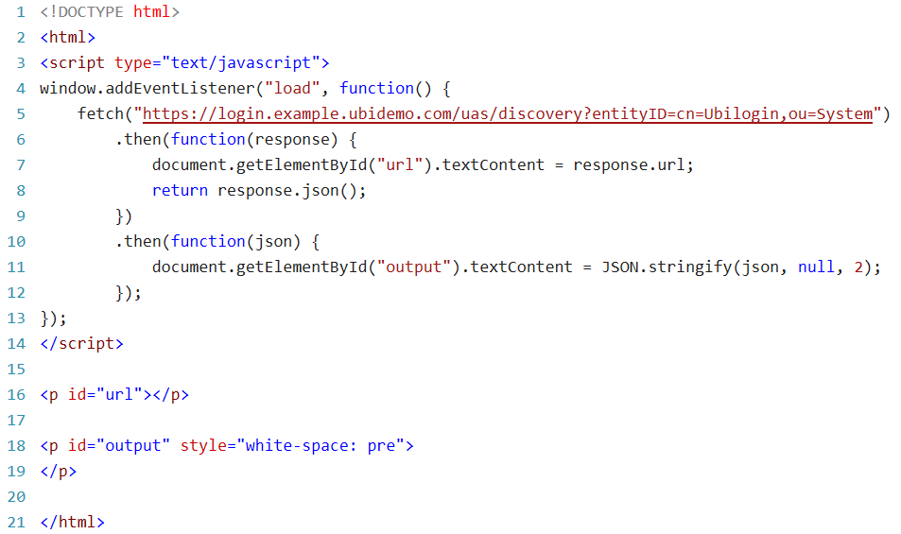
UI and UX – Examples
Using JavaScript Fetch to get Discovery information

Slide 6
UI and UX
Session Status API
SSO session information at IDP
Is the SSO session still valid? When will it expire? When did the user authenticate?
Use refresh option to keep the SSO session alive
SSO and JavaScript
Inject custom JavaScript into SSO logon UI
Implement customizations that are not possible with template settings
UI and UX APIs are CORS enabled

Slide 7
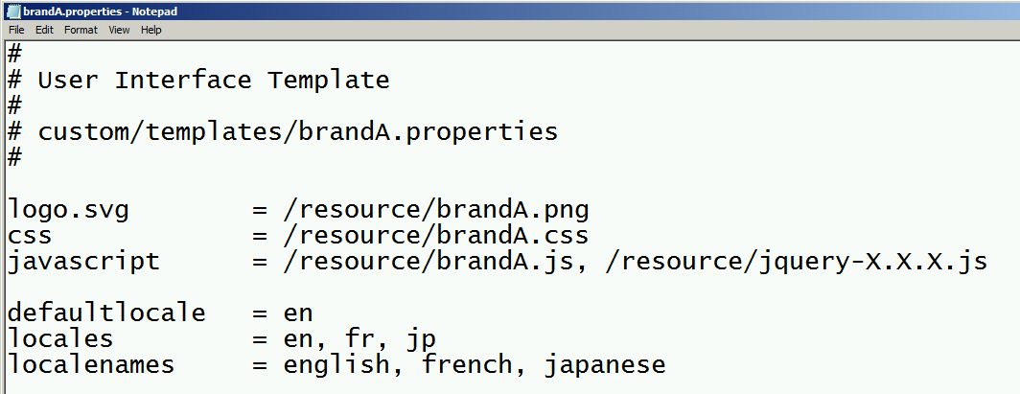
UI and UX - Examples
SSO and JavaScript

Slide 8
Application integration
Web SSO
OAuth 2.0 and OpenID Connect 1.0
SAML 2.0
Java and ASP.NET integration modules
Mobile Applications
OAuth 2.0 and OpenID Connect 1.0
API protection
OAuth 2.0

Slide 9
OAuth 2.0 and OpenID Connect 1.0
Overview
Discovery
Registration
Authentication
With web browser
Backend protocols
Token validation and revocation
Message integrity and confidentiality

Slide 10
Overview
OAuth 2.0 – by IETF
https://tools.ietf.org/wg/oauth/
OpenID Connect 1.0 – by OpenID Foundation
Builds on OAuth 2.0
Authentication Request with more parameters
ID Token and Claims
https://openid.net/connect/
Real world applications will use features from both

Slide 11
Discovery
Discovery – find out information needed to interact with an IDP
Information contents
Supported features
Service endpoints
Cryptographic keys and supported algorithms
Specification
RFC 8414 – Authorization Server Metadata
OpenID Connect Discovery
URL
https://login.example.ubidemo.com/uas/.well-known/oauth-authorization-server
https://login.example.ubidemo.com/uas/.well-known/openid-configuration

Slide 12
Registration
Register an OAuth/OIDC application with an IDP
Part of SSO Management API in Ubisecure IAM
Registration request by default generates client_id and client_secret
Specification
RFC 7592 – Dynamic Client Registration Management Protocol
URL – application identifier with metadata suffix, example
https://manage.example.ubidemo.com/sso-api/application/iam-academy/public/$attribute/metadata

Slide 13
Registration
Example
PUT https://manage.example.ubidemo.com/sso-api/application/iam-academy/example/$attribute/metadata HTTP/1.1
Content-Type: application/json
{
"redirect_uris": [
"http://localhost/example"
]
}
HTTP/1.1 200 OK
Content-Type: application/json
{
"redirect_uris": [
"http://localhost/example"
],
"client_id": "d07398b0-5c7e-466d-974b-908eef64bb22",
"client_secret": "EJKj3oz2rv0D3UogaSASJaGd0laxieSd"
}

Slide 14
Authentication – with web browser
Authentication request
Specification
OpenID Connect Authentication Request
Endpoint
authorization_endpoint
Required parameters
response_type = code
client_id
redirect_uri
Redirection when completed
Redirect uri receives authorization code
Token request
Specification
RFC 6749 – OAuth 2.0 Token Request
Endpoint
token_endpoint
Required parameters
grant_type = authorization_code
client_id and client_secret
redirect_uri
code
Returns Access Token and optionally ID Token and Refresh Token

Slide 15
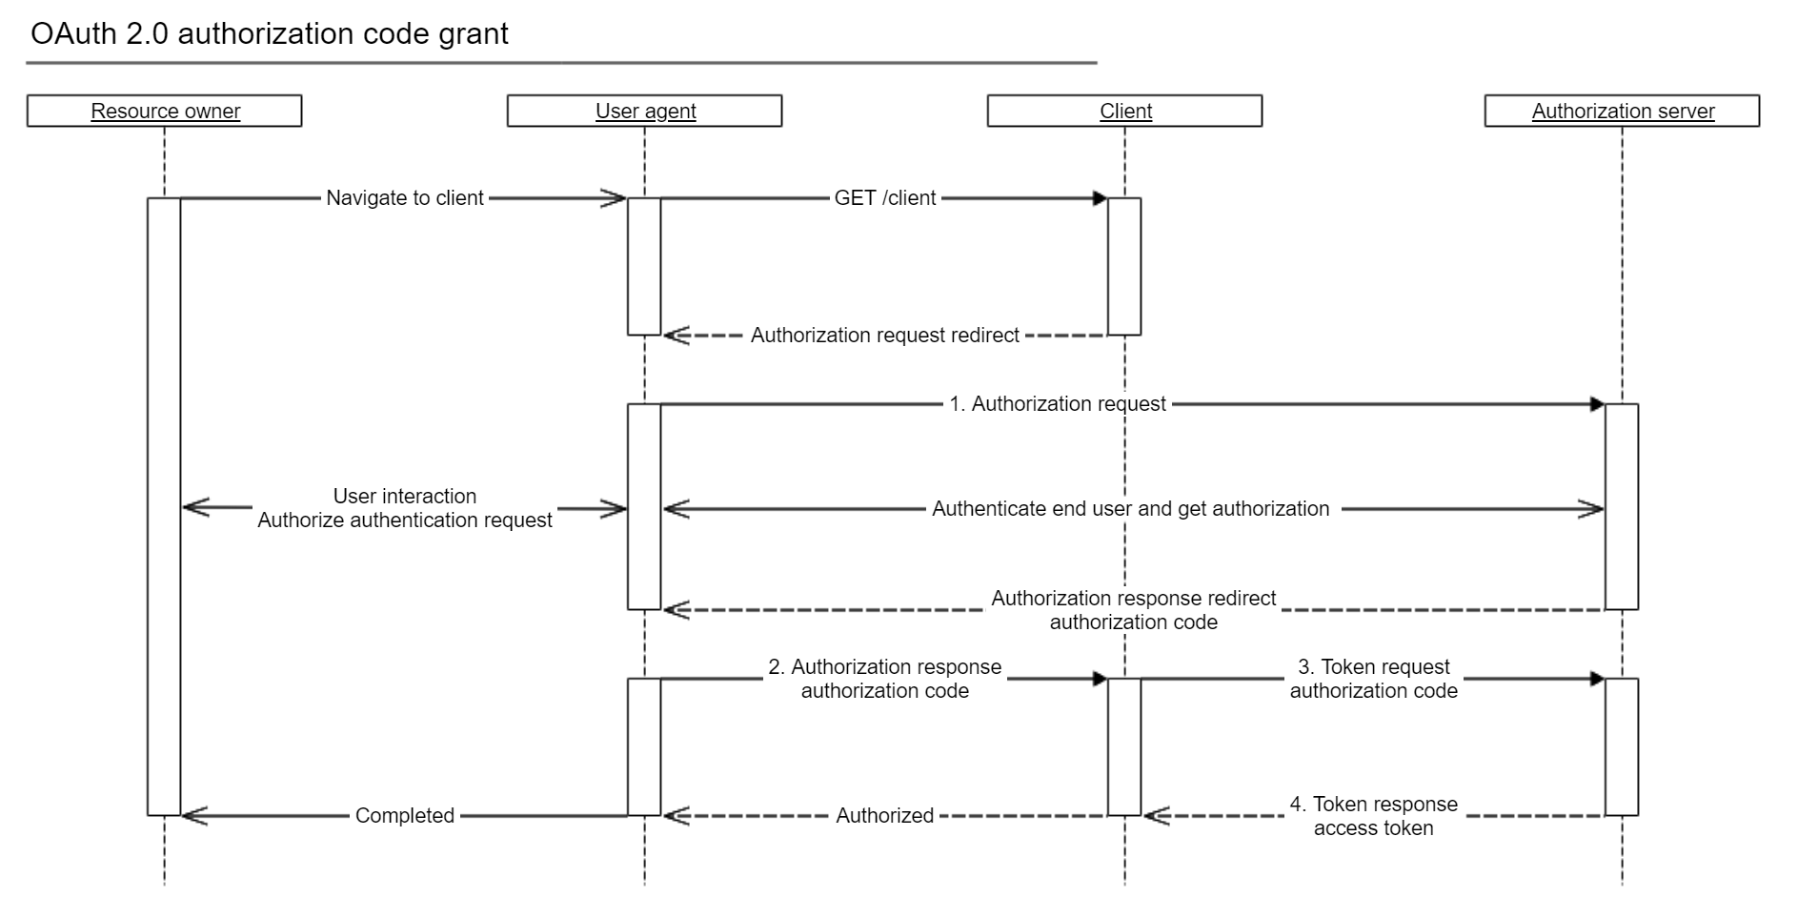

Slide 16
Authentication – backend protocols
Password grant
Specification
RFC 6749 – Password grant
Endpoint
token_endpoint
Required parameters
grant_type = password
client_id and client_secret
username
password
Refresh token
Specification
RFC 6749 – Refresh token
Endpoint
token_endpoint
Required parameters
grant_type = refresh_token
client_id and client_secret
refresh_token

Slide 17
Authentication – backend protocols
Ubisecure IAM extensions for SMS OTP and SMTP OTP
Endpoint
token_endpoint
Required parameters – first request
grant_type = sms-mt-otp | smtp-otp
username
Required parameters – final request
grant_type = sms-mt-otp | smtp-otp
otp_code
reference_id

Slide 18
Token validation and revocation
OpenID Connect UserInfo
For access token validation
Specification
OpenID Connect UserInfo
Endpoint
userinfo_endpoint
Required parameters
Authorization header with access token
ID Token
Signed JWT, optionally encrypted
Specification
OpenID Connect ID Token
Token Introspection
For access and refresh token validation
Specification
RFC 7662 – Token Introspection
Endpoint
introspection_endpoint
Required parameters
client_id and client_secret
token
Token Revocation
For access and refresh token revocation
Specification
RFC 7009 – Token Revocation
Endpoint
revocation_endpoint
Required parameters
client_id and client_secret
token

Slide 19
Message integrity and confidentiality
Using JWTs for Client Authentication
https://tools.ietf.org/html/rfc7523#section-2.2
JWT Secured Authorization Request
https://tools.ietf.org/html/draft-ietf-oauth-jwsreq-16
JWT Response for OAuth Token Introspection
https://tools.ietf.org/html/draft-ietf-oauth-jwt-introspection-response-01
ID Token signing and encryption
https://openid.net/specs/openid-connect-registration-1_0.html#ClientMetadata
UserInfo signing and encryption
https://openid.net/specs/openid-connect-registration-1_0.html#ClientMetadata

Slide 20
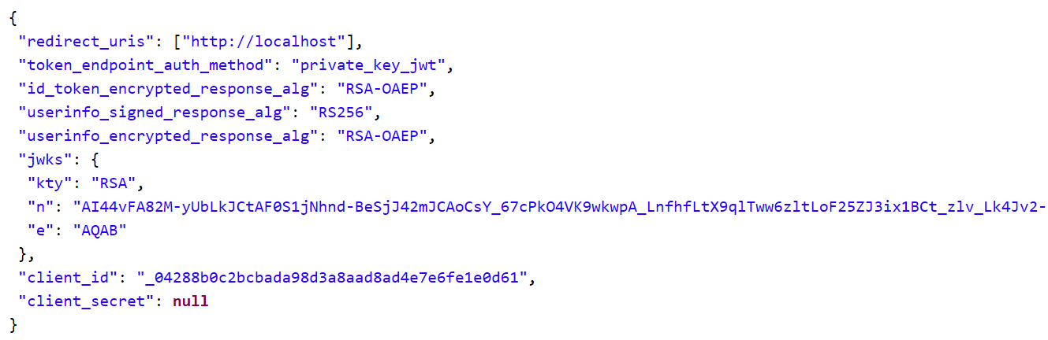
Message integrity and confidentiality
Example configuration with JWT client authentication and
encrypted ID Token and UserInfo

Slide 21
DevOps and Automation
SSO Management API
Management Console automation
Applications
Register and manage applications
Manage access control and authorization policies
Authentication methods and inbound trust
Register new authentication methods
Manage inbound trust relationship (SAML 2.0, OpenID Connect 1.0)
PowerShell bindings (Windows and Linux)

Slide 22
DevOps and Automation – Examples
Import-Module "oauth2"
Import-Module "sso-api-v2"
$sso_config = @{
"ManageUri"="https://manage.example.ubidemo.com"
"Uri"="https://login.example.ubidemo.com"
}
$registration = @{
"ClientId"="public"
"ClientSecret"=(ConvertTo-SecureString -String "public" -AsPlainText -Force)
"RedirectUri"="http://localhost/public"
}
New-OAuthClientConfig @registration | New-SSOLogon @sso_config -Browser "default"

Slide 23
DevOps and Automation – Examples
# GET /group/System/Authenticated Users
$users = Get-SSOObject -Type "group" "System","Authenticated Users"
# GET /method/password.1
$password1 = Get-SSOObject -Type "method" "password.1"
# PUT /site/iam-academy
$site = Set-SSOObject -Type "site" "iam-academy"
# PUT /site/iam-academy/$link/method/password.1
$site | Set-SSOLink $password1 | Out-Null
# PUT /aplication/iam-academy/example
$application = $site | Set-SSOChild -ChildType "application" "example" -Enabled
# PUT /aplication/iam-academy/example/$link/method/password.1
$application | Set-SSOLink $password1 -Enabled | Out-Null
# PUT /aplication/iam-academy/example/$link/allowedTo/...
$application | Set-SSOLink -LinkName "allowedTo" $users | Out-Null
# PUT /policy/iam-academy/policy
$policy = $site | Set-SSOChild -ChildType "policy" "policy"
# PUT /aplication/iam-academy/example/$link/policy/iam-academy/policy
$application | Set-SSOLink $policy | Out-Null
# PUT /aplication/iam-academy/example/$attribute/metadata
$metadata = @{
”Name"=”metadata"
"ContentType"="application/json"
"Body"='{"redirect_uris":["http://localhost/example"]}'
}
$registration = $application | Set-SSOAttribute @metadata

Slide 24
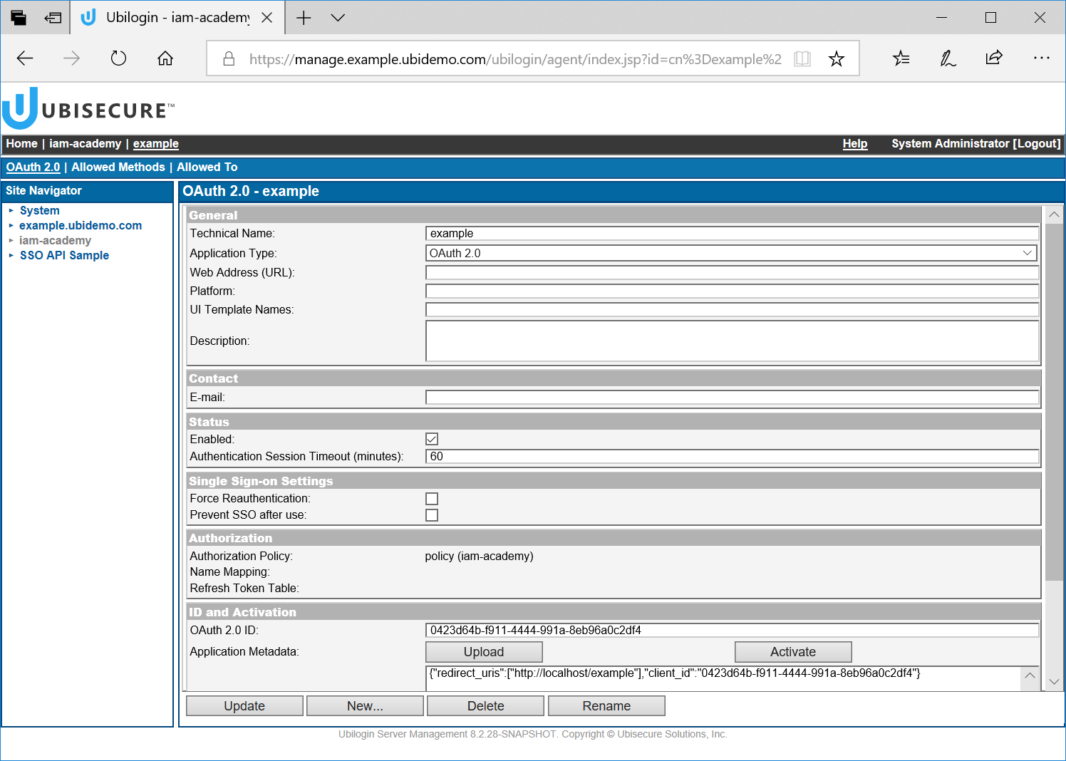

Slide 25
IAM Process
CustomerID API
Implement simple provisioning use cases
Invoke functions present in CustomerID UI from API
Register and invite users
Manage organizations, roles and mandates
OTP List Server API
Generate and manage OTP printout lists

Slide 26
IAM Process – Example
curl "https://example.ubidemo.com/customerid-rest/services/2.1/users/?username=restuser&password=secret"
<Users xmlns="http://schema.ubisecure.com/customerid/api" inResponseTo="/2.1/users" method="GET">
<Id>USERID1</Id>
<Id>USERID2</Id>
</Users>

Slide 27
Callback APIs
Where Ubisecure IAM products act as client
Directory Mapping
For mapping external identities into local identities
Invoked after SSO logon
CustomerID Backend Query
For validation and enrichment of user information
Invoked from CustomerID workflow
Authentication Methods
SAML and OpenID Connect for frontend integration
CIBA for backend integration
Invoked from SSO logon

Slide 28
Summary
Ubisecure product platform includes extensive APIs for third-party integration
When possible APIs are based on open industry standards
APIs are first priority for Ubisecure!

Slide 29
Thank You!

